Slide 1
Instance-based Learning
Dr. Sugata Ghosal
sugata.ghosal@pilani.bits-pilani.ac.in

Slide 2
Text Book(s)
T1 | Christopher Bishop: Pattern Recognition and Machine Learning, Springer International Edition
T2 | Tom M. Mitchell: Machine Learning, The McGraw-Hill Companies, Inc..
These slides are prepared by the instructor, with grateful acknowledgement of Prof. Tom Mitchell, Prof.. Burges, Prof. Andrew Moore and many others who made their course materials freely available online.

Slide 3
Topics to be covered
Instance based learning
K-Nearest Neighbour Learning
Locally Weighted Regression (LWR) Learning
Radial Basis Functions

Slide 4
k-Nearest Neighbor Classifier
Nearest Neighbour classifier is an instance based classifier
‘lazy learning’, as learning is postponed until a new instance is encountered
Constructs a local approximation to the target function, applicable in the neighbourhood of new instance
Suitable in cases where target function is complex over the entire input space, but easily describable in local approximations
Real world applications found in recommendation systems (amazon).
Caveat is the high cost of classification, which happens at the time of processing rather than before hand (there’s no training phase)

Slide 5
Instance Based Learning
Key idea: just store all training examples <x_{i},f(x_{i})>
Nearest neighbor:
Given query instance x_{q}, first locate nearest training example x_{n}, then estimate f*(x_{q})=f(x_{n})
K-nearest neighbor:
Given x_{q}, take vote among its k nearest neighbors (if discrete-valued target function)
Take mean of f values of k nearest neighbors (if real-valued) f*(x_{q})=Σ_{i=1}^{k} f(x_{i})/k

Slide 6
When to Consider Nearest Neighbors
Instances map to points in R^{N}
Less than 20 attributes per instance
Lots of training data
Advantages:
Training is very fast
Learn complex target functions
Do not lose information
Disadvantages:
Slow at query time
Easily fooled by irrelevant attributes

Slide 7
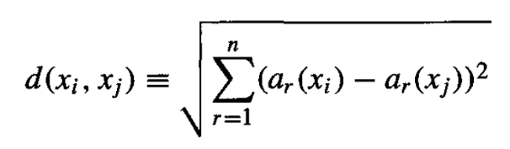
k-Nearest Neighbor Classifier
Considers all instances as members of n-dimensional space
Nearest neighbours of an instance is determined based on Euclidean distance
Distance between two n-dimensional instances x_{i} and x_{j} is given by:
For nearest neighbour classifier, target function can be discrete or continuous

Slide 8
Distance Measures : Special Cases of Minkowski
h = 1: Manhattan (city block, L₁ norm) distance
h = 2: (L₂ norm) Euclidean distance
h → ∞. “supremum” (L_{max} norm, L∞ norm) distance.
This is the maximum difference between any component (attribute) of the vectors

Slide 9
Standardizing Numeric Data
X: raw score to be standardized, μ: mean of the population, σ: standard deviation
the distance between the raw score and the population mean in units of the standard deviation
negative when the raw score is below the mean, “+” when above
Where

Slide 10
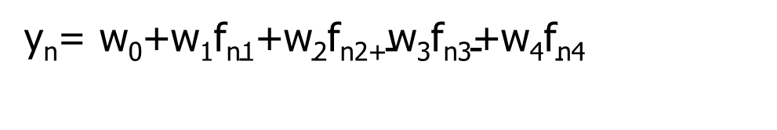
Multiple Features
y_{n}= $\text{w}\text{0}\text{+}\text{w}\text{1}\text{f}\text{n}\text{1}\text{+}\text{w}\text{2}\text{f}\text{n}\text{2+}\text{w}\text{3}\text{f}\text{n}\text{3}\text{+}\text{w}\text{4}\text{f}\text{n}\text{4}$
Size (feet²) f1 | Number of bedrooms f2 | Number of floors f3 | Age of home (years) f4 | Price ($1000) y
2104 | 5 | 1 | 45 | 460
1416 | 3 | 2 | 40 | 232
1534 | 3 | 2 | 30 | 315
852 | 2 | 1 | 36 | 178
… | … | … | … | …

Slide 11
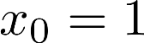
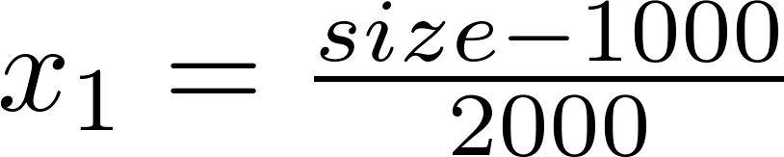
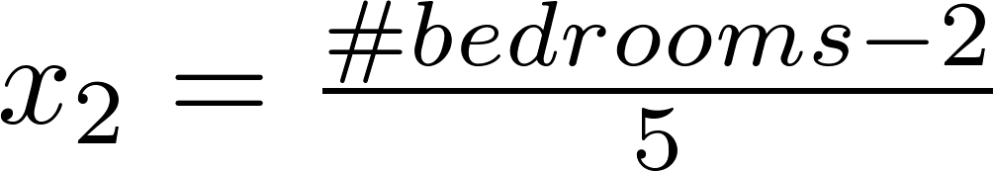
Feature scaling
Feature scaling of features x_{i} consists of rescaling the range of features to scale the range in [0, 1] or [−1, 1] (Do not apply to )
Average value of x1
E.g.
Maximum value of x1 – min value of x1

Slide 12
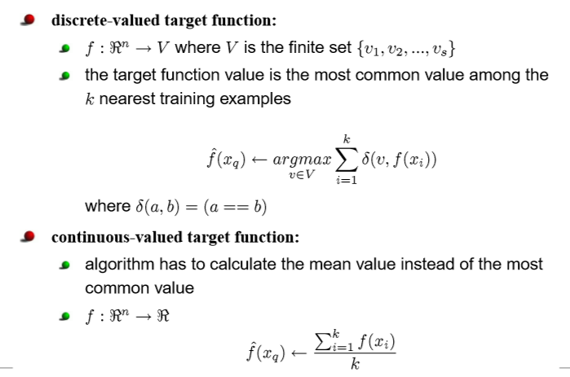
Discrete and Continuous-valued function

Slide 13
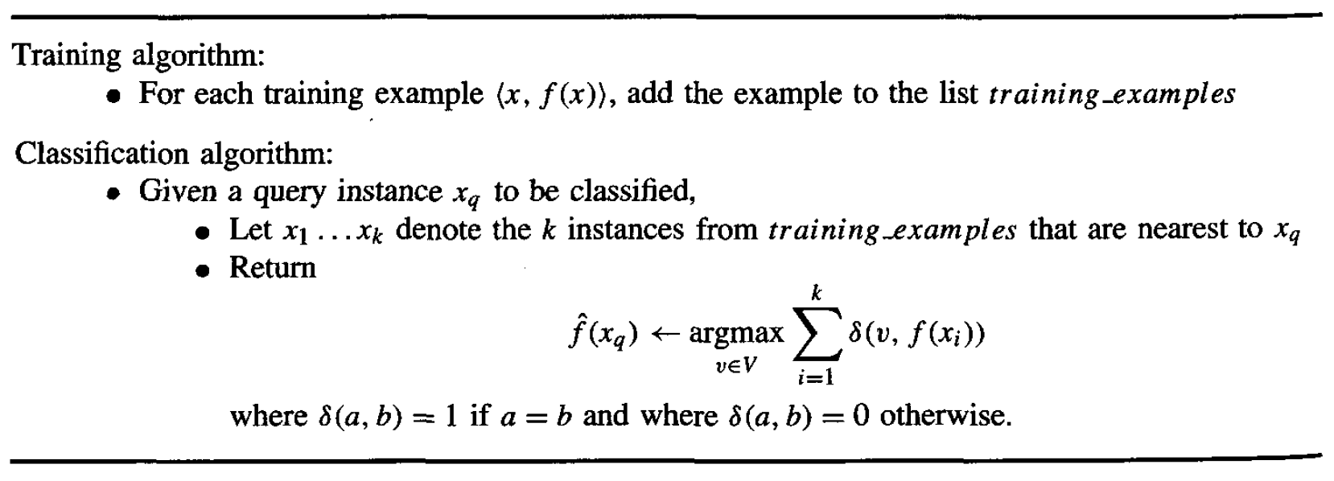
k-Nearest Neighbor Classifier
* It can be used for Regression as well.

Slide 14
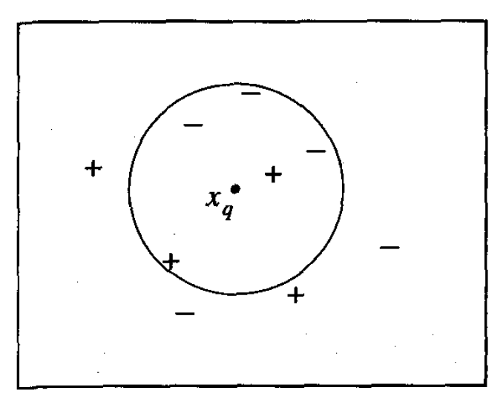
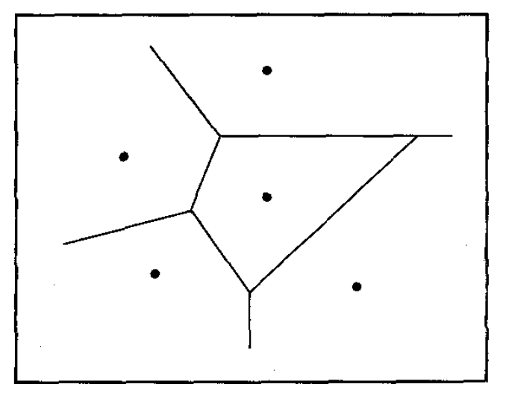
k-NN examples
K=1
K=5

Slide 15
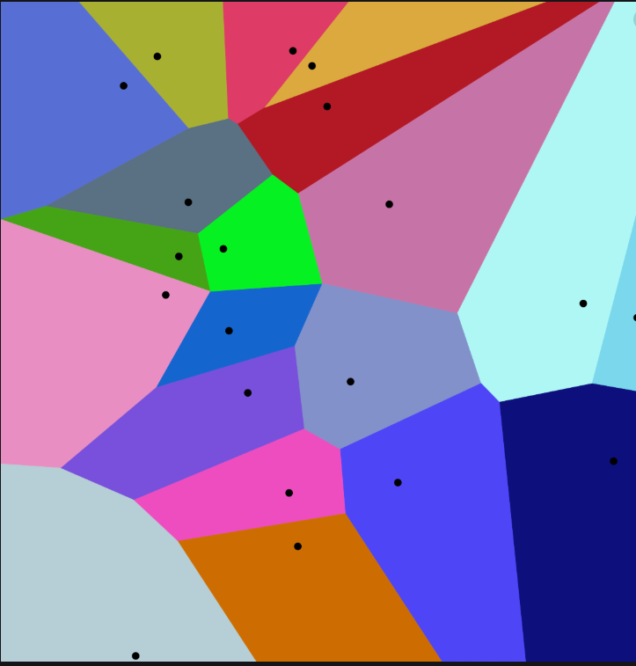
Voronoi Diagram
It is a partition of a plane into regions close to each of a given set of objects.

Slide 16
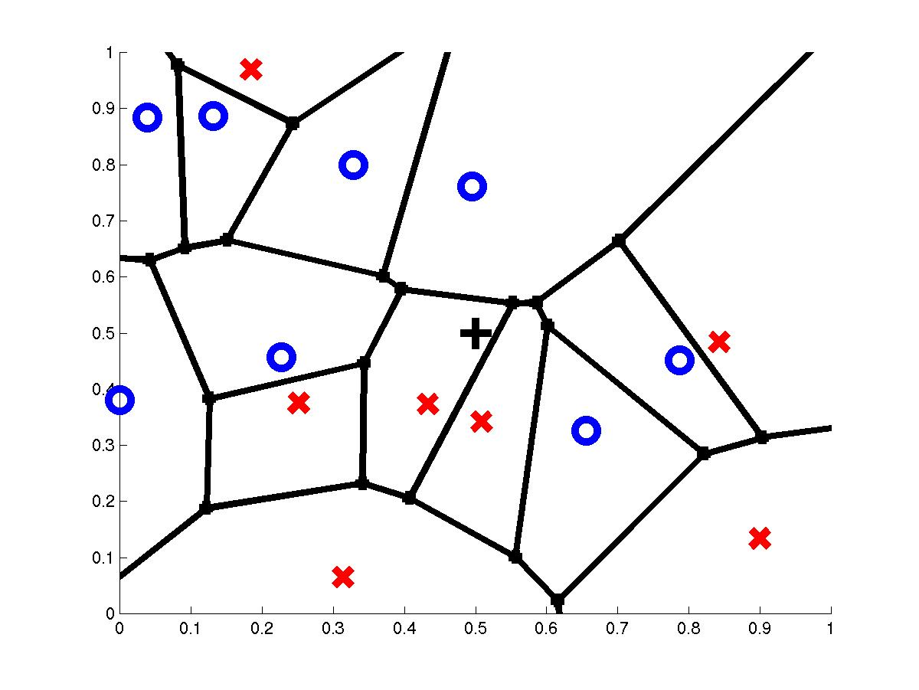
Voronoi Diagram
query point q_{f}
nearest neighbor q_{i}

Slide 17
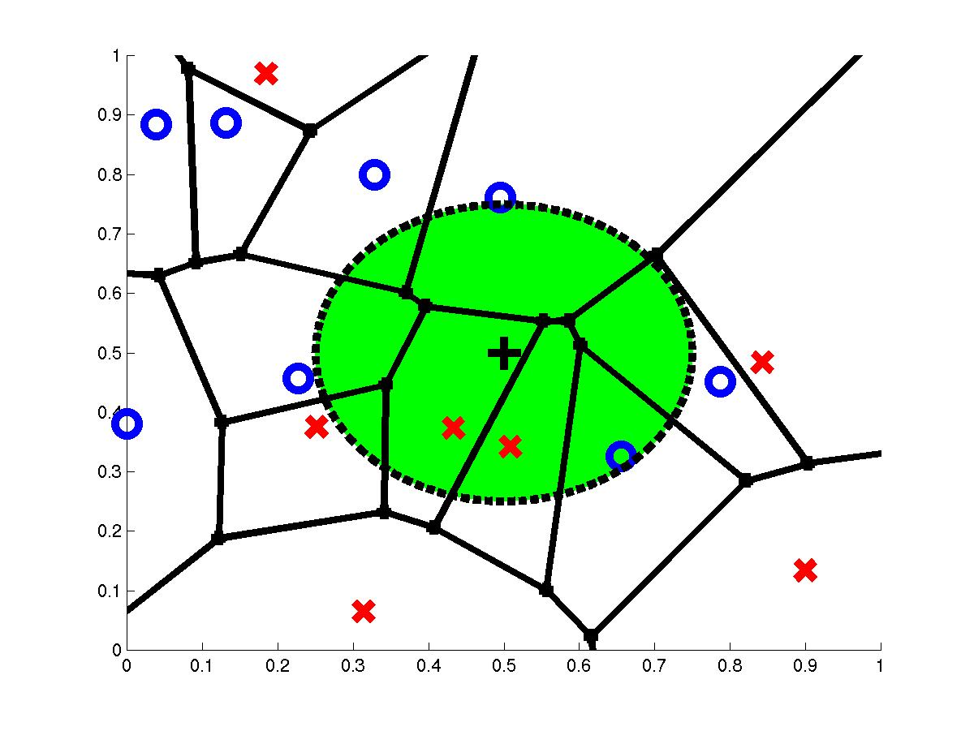
3-Nearest Neighbors
query point q_{f}
3 nearest neighbors
2x,1o

Slide 18
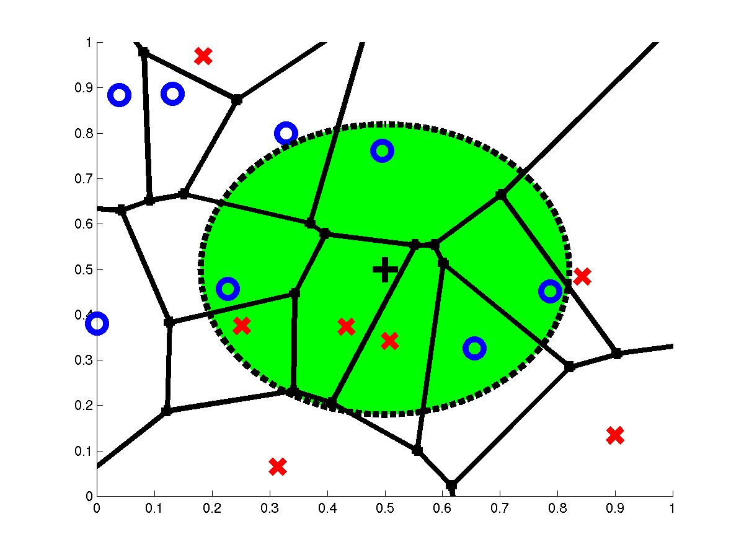
7-Nearest Neighbors
query point q_{f}
7 nearest neighbors
3x,4o

Slide 19
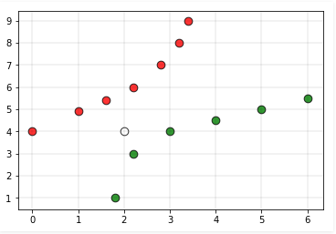
Various issues that affect the performance of kNN:
Performance of a classifier largely depends on the of the hyperparameter k
Choosing smaller values for K, noise can have a higher influence on the result.
Larger values of k are computationally expensive
Assigning the class labels can be tricky. For example, in the below case, for (k=5) the point is closer to ‘green’ classification, but gets classified as ‘red’ due to higher red votes/majority voting to ‘red’

Slide 20
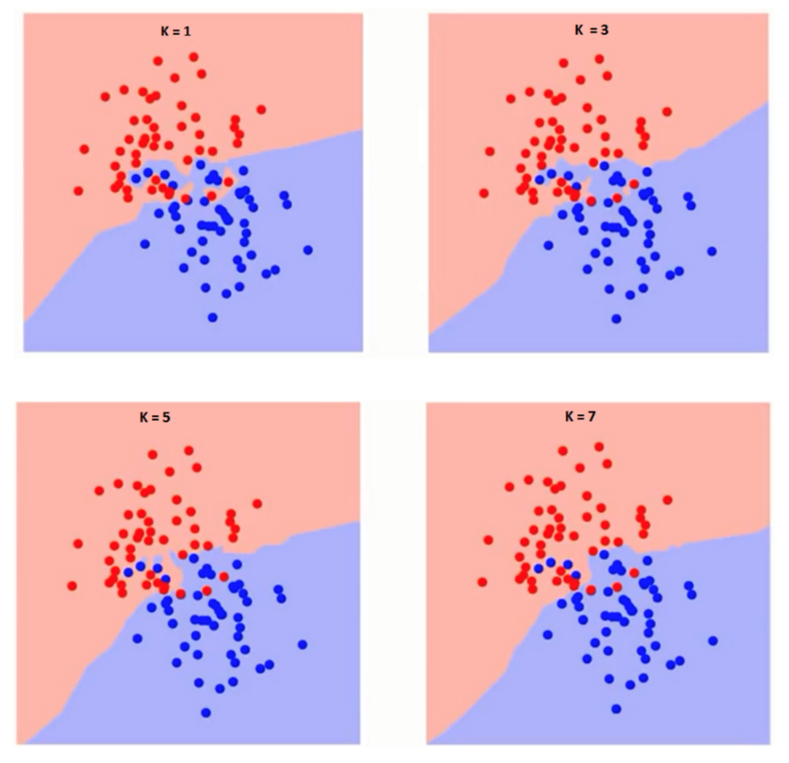
Finding optimal k for kNN classifiers

Slide 21
Finding K - Elbow method
Compute sum of squares error (SSE) or any other error function for varying values of K (1 to a reasonable X) and plot against K
In the plot, the elbow (see pic) gives the value of K beyond which the error function plot almost flattens
As K approaches the total number of instances in the set, error function drops down to ‘0’, but beyond optimal K, the model becomes too generic
Error function (SSE)
K value

Slide 22
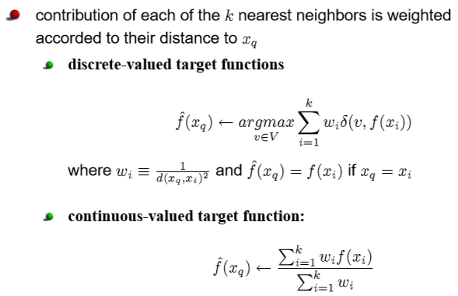
Distance weighted nearest neighbor

Slide 23
Distance Weighted k-NN
Give more weight to neighbors closer to the query point
f*(x_{q}) = Σ_{i=1}^{k} w_{i} f(x_{i}) / Σ_{i=1}^{k} w_{i} ;
w_{i}=K(d(x_{q},x_{i}))
and
d(x_{q},x_{i}) is the distance between x_{q} and x_{i}
Variation: Instead of only k-nearest neighbors use all training examples (Shepard’s method)

Slide 24
Distance Weighted Average
Weighting the data
f*(x_{q}) = Σ_{i} f(x_{i}) K(d(x_{i},x_{q}))/ Σ_{i} K(d(x_{i},x_{q}))
Relevance of a data point ( x _{i}, f(x _{i}) ) is measured by calculating the distance d( x _{i} , x _{q} ) between the query x _{q} and the input vector x _{i}
Weighting the error criterion
E(x_{q}) = Σ_{i} (f*(x_{q})-f(x_{i}))² K(d(x_{i},x_{q}))
Best estimate f*(x_{q}) will minimize the cost E(x_{q}), therefore
∂E(x_{q})/∂f*(x_{q})=0

Slide 25
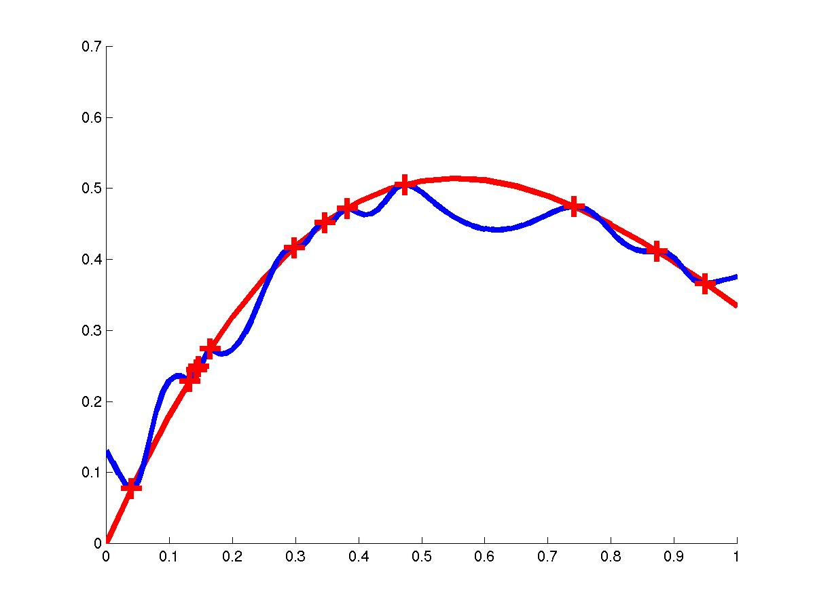
Distance Weighted NN
K(d(x_{q},x_{i})) = 1/ d(x_{q},x_{i})²

Slide 26
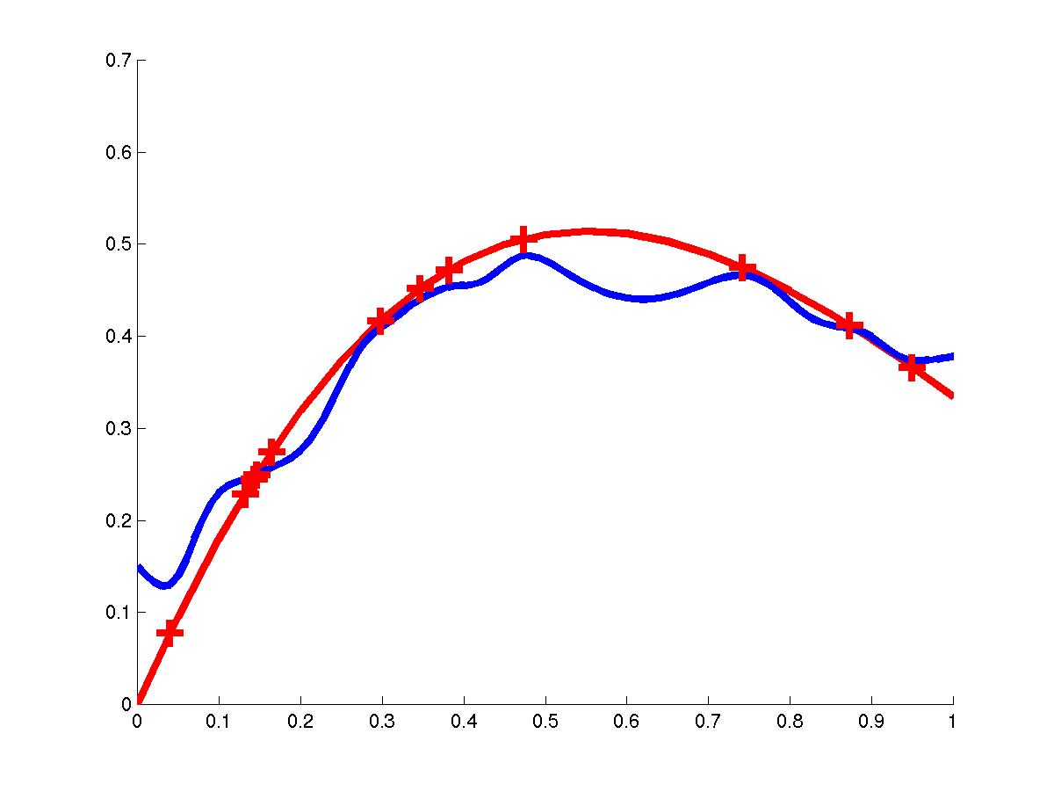
Distance Weighted NN
K(d(x_{q},x_{i})) = 1/(d₀+d(x_{q},x_{i}))²

Slide 27
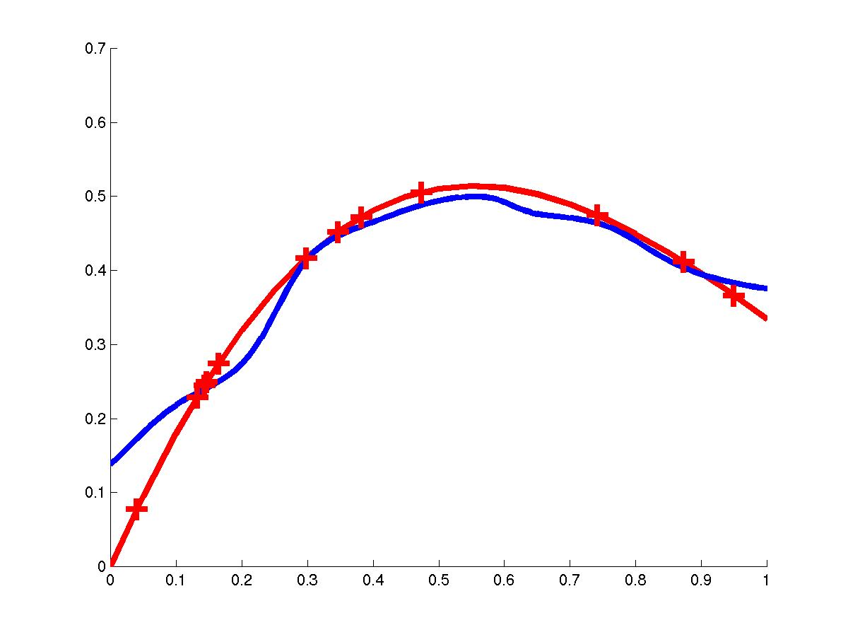
Distance Weighted NN
K(d(x_{q},x_{i})) = exp(-(d(x_{q},x_{i})/σ₀)²) – Gaussian weighted

Slide 28
Curse of Dimensionality
Imagine instances described by 20 attributes but only a few are relevant to target function
Curse of dimensionality: nearest neighbor is easily misled when instance space is high-dimensional
One approach:
Stretch j-th axis by weight z_{j}, where z₁,…,z_{n} chosen to minimize prediction error
Use cross-validation to automatically choose weights z₁,…,z_{n}
Note setting z_{j} to zero eliminates this dimension alltogether (feature subset selection)

Slide 29
Locally Weighted Regression

Slide 30
Locally Weighted Regression
Locally – Function approximated based on data near query point
Weighted – Contribution by each training example is weighted by its distance from query point
Regression- Approximates real-valued target function

Slide 31
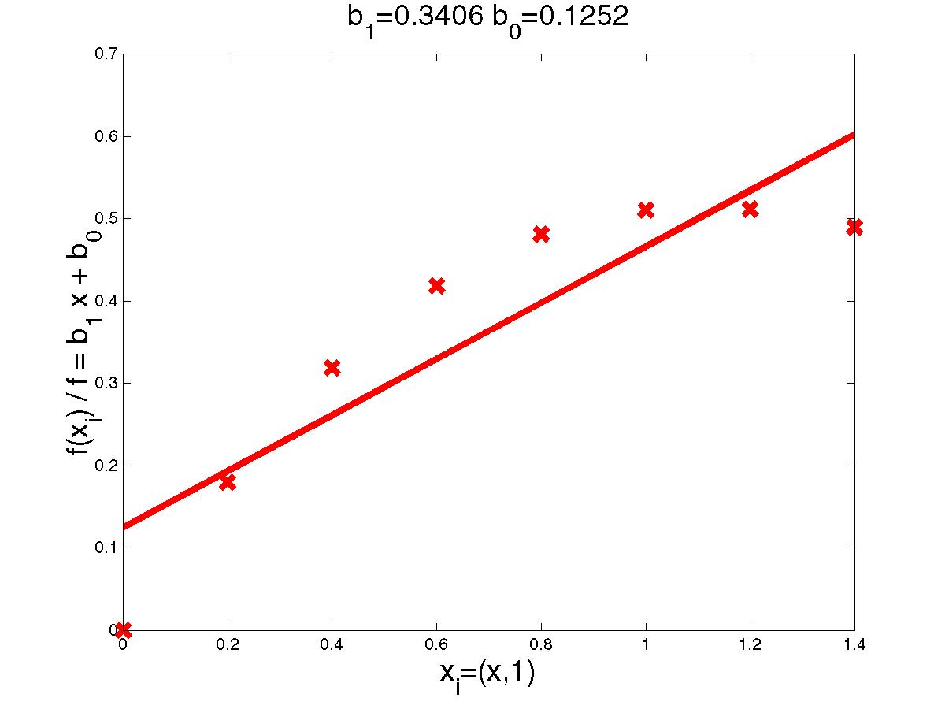
Linear Regression Example

Slide 32
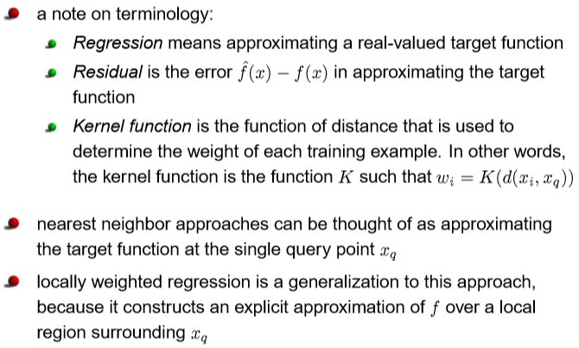
Locally weighted regression

Slide 33
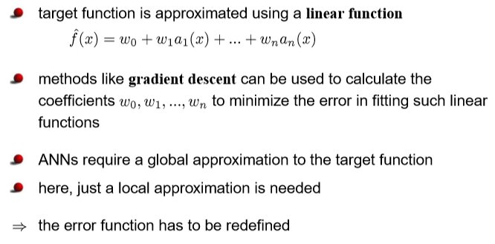
Locally weighted regression

Slide 34
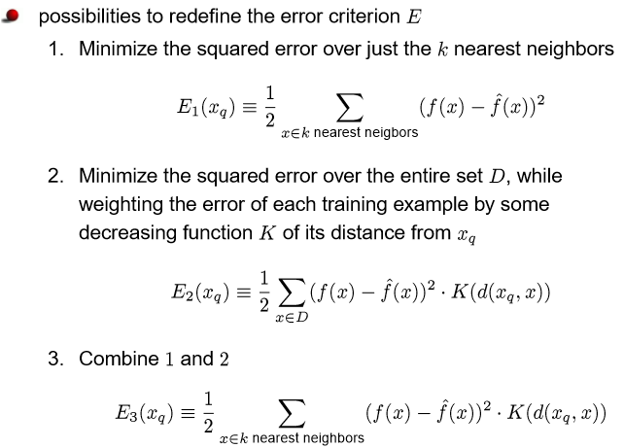
Locally weighted regression

Slide 35
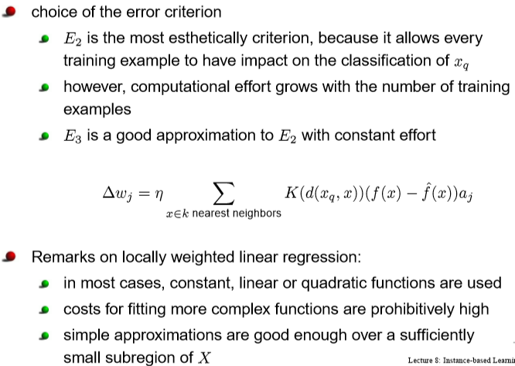
Locally weighted regression

Slide 36
Design Issues in Local Regression
Local model order (constant, linear, quadratic)
Distance function d
feature scaling: d(x,q)=(Σ_{j=1}^{d} m_{j}(x_{j}-q_{j})²)^{1/2}
irrelevant dimensions m_{j}=0
kernel function K
See paper by Atkeson [1996] ”Locally Weighted Learning”

Slide 37
Radial Basis Function

Slide 38
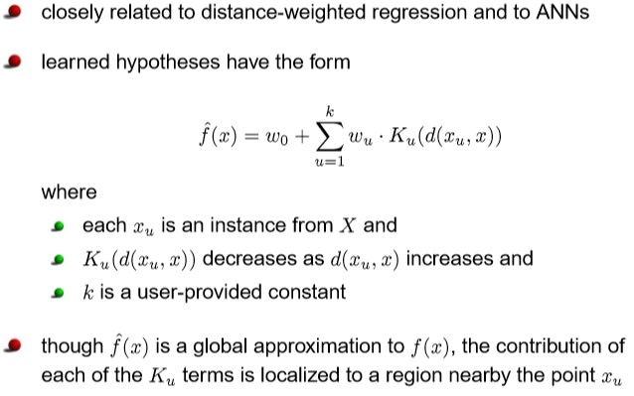
Radial Basis Function

Slide 39
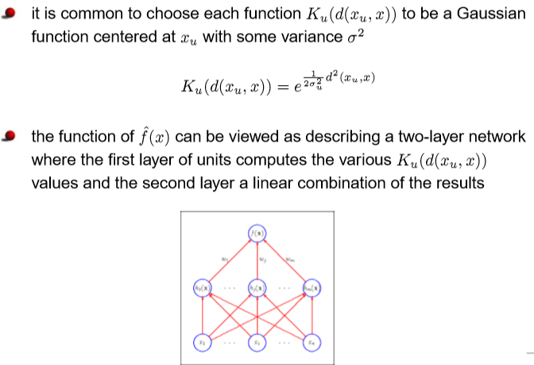
Radial Basis Function
-

Slide 40
Training Radial Basis Function Networks
How to choose the center x_{n} for each Kernel function K_{n}?
scatter uniformly across instance space
use distribution of training instances (clustering)
How to train the weights?
Choose mean x_{n} and variance σ_{n} for each K_{n}
say, by using non-linear optimization or EM
Hold K_{n} fixed and use local linear regression to compute the optimal weights w_{n}

Slide 41
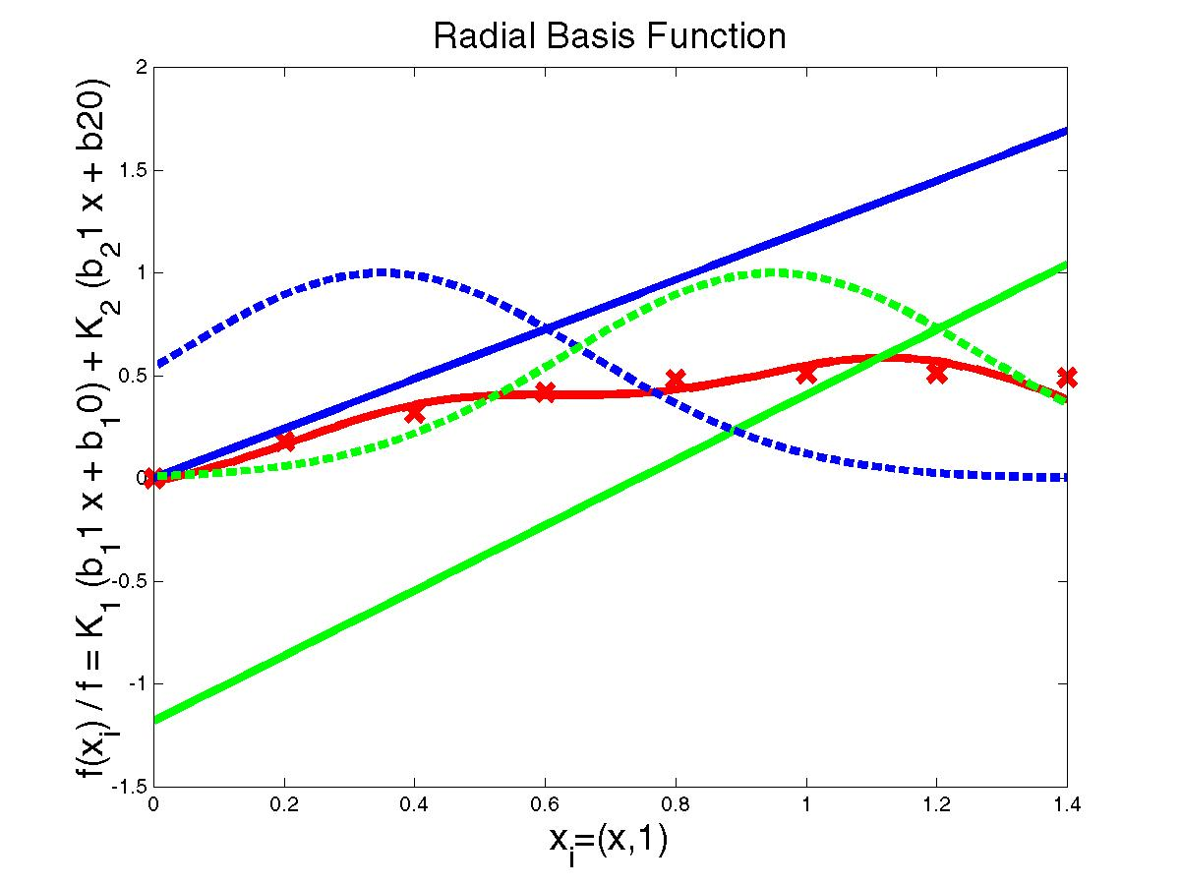
Radial Basis Network Example
K₁(d(x₁,x))=
exp(-1/2 d(x₁,x)²/σ²)
w₁ x+ w₀
f^(x) = K₁ (w₁ x+ w₀)
+ K₂ (w₃ x + w₂)

Slide 42
Lazy and Eager Learning
Lazy: wait for query before generalizing
k-nearest neighbors, weighted linear regression
Eager: generalize before seeing query
Radial basis function networks, decision trees, back-propagation
Eager learner must create global approximation
Lazy learner can create local approximations
If they use the same hypothesis space, lazy can represent more complex functions (H=linear functions)

Slide 43
Confusion Matrix
True Positive (TP): It refers to the number of
predictions where the classifier correctly predicts
the positive class as positive.
True Negative (TN): It refers to the number of
predictions where the classifier correctly predicts
the negative class as negative.
False Positive (FP): It refers to the number of
predictions where the classifier incorrectly
predicts the negative class as positive.
False Negative (FN): It refers to the number of
predictions where the classifier incorrectly predicts
the positive class as negative.
Predicted class -> | C₁ | ¬ C₁
Actual class⇓
C₁ | True Positives (TP) | False Negatives (FN)
¬ C₁ | False Positives (FP) | True Negatives (TN)
43

Slide 44
Classifier Evaluation Metrics: Accuracy, Error Rate
Classifier Accuracy, or recognition rate: percentage of test set tuples that are correctly classified
Accuracy = (TP + TN)/All
most effective when the class distribution is relatively balanced
Classification Error/ Misclassification rate
Misclassification rate =1 – accuracy,
= (FP + FN)/All
A\P | C | ¬C
C | TP | FN | P
¬C | FP | TN | N
 | P’ | N’ | All

Slide 45
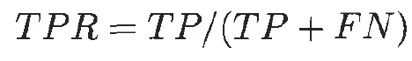
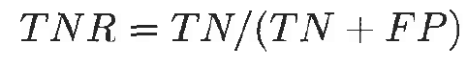
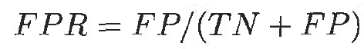
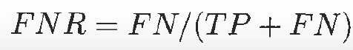
Metrics - Basics
True positive rate (TPR) or sensitivity is defined as the fraction of positive examples predicted correctly by the model
True negative rate (TNR) or specificity is defined as the fraction of negative examples predicted correctly by the model
False positive rate (FPR) is the fraction of negative examples predicted as a positive class
False negative rate (F N R) is the fraction of positive examples predicted as a negative class

Slide 46
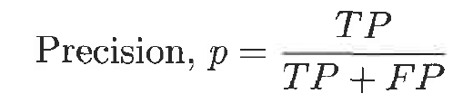
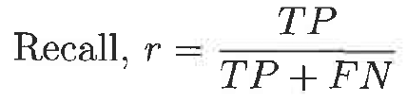
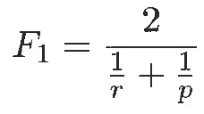
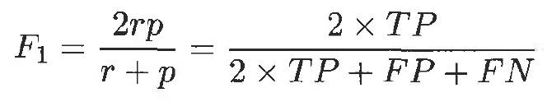
Precision, Recall & F1
Precision determines the fraction of records that actually turns out to be positive in the group the classifier has declared as a positive class
The higher the precision is, the lower the number of false positive errors committed by the classifier
Recall (same as TPR) measures the fraction of positive examples correctly predicted by the classifier
Classifiers with large recall have very few positive examples misclassified as the negative class
Harmonic between precision & recall is known as F₁ measure
High value of F₁ measure ensures that both precision and recall are high

Slide 47
Evaluating Classifier Accuracy: Holdout & Cross-Validation Methods
Holdout method
Given data is randomly partitioned into two independent sets
Training set (e.g., 2/3) for model construction
Test set (e.g., 1/3) for accuracy estimation
Random sampling: a variation of holdout
Repeat holdout k times, accuracy = avg. of the accuracies obtained
Cross-validation (k-fold, where k = 10 is most popular)
Randomly partition the data into k mutually exclusive subsets, each approximately equal size
At i-th iteration, use D_{i} as test set and others as training set
The Accuracy of the model is the average of the accuracy of each fold.
47

Slide 48
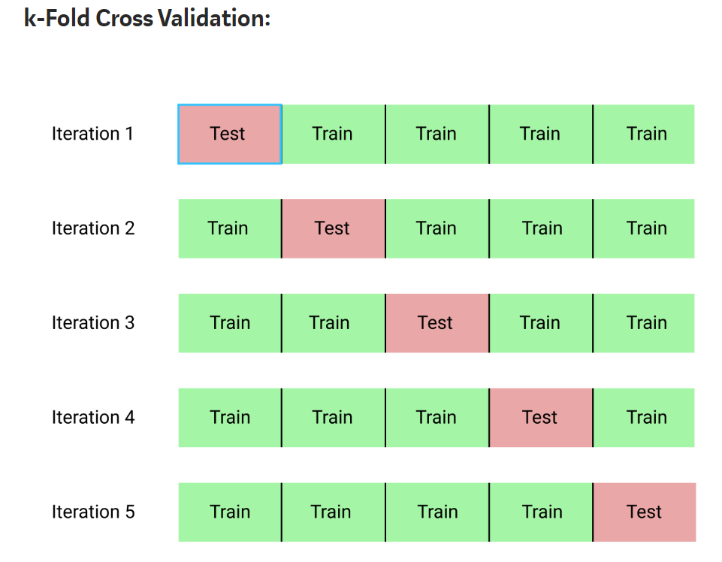
Cross Validation

Slide 49
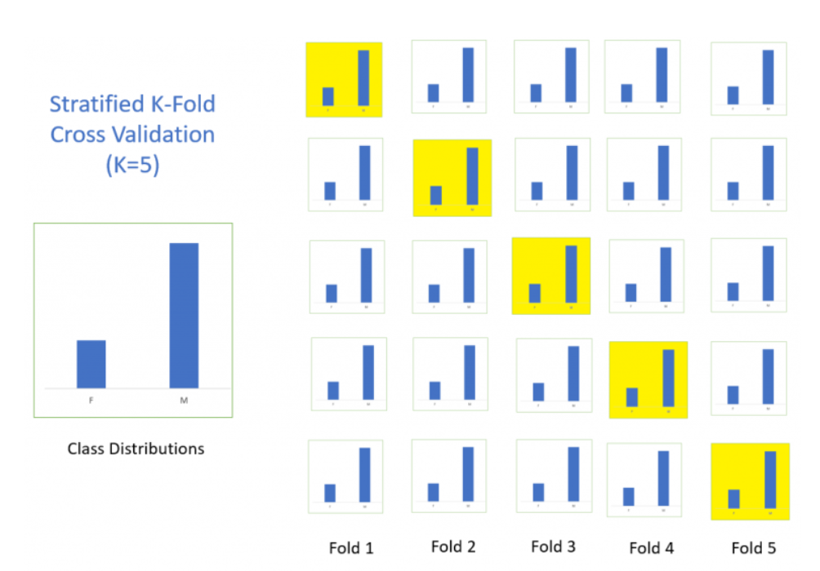
Stratified Cross Validation

Slide 50
Literature & Software
T. Mitchell, “Machine Learning”, chapter 8, “Instance-Based Learning”
“Locally Weighted Learning”, Christopher Atkeson, Andrew Moore, Stefan Schaal
R. Duda et al., “Pattern recognition”, chapter 4 “Non-Parametric Techniques”
Netlab toolbox
k-nearest neighbor classification
Radial basis function networks

Slide 51
Exercise - 1
Consider the following training set in 2-dimensional Euclidean space What is the class of the point (1, 1) if 7NN classifier is considered? If the value of K is reduced whether the class will change? (Consider K=3 and K=5). What should be the final class if the above 3 values of K are considered?
Point | Coordinate | Class
X1 | (-1, 1) | Negative
X2 | (0, 1) | Positive
X3 | (0, 2) | Negative
X4 | (1, -1) | Negative
X5 | (1, 0) | Positive
X6 | (1, 2) | Positive
X7 | (2, 2) | Negative
X8 | (2, 3) | Positive

Slide 52
Exercise -1
Point | Coordinate | Class | Distance from 1,1
X1 | (-1, 1) | Negative | 2
X2 | (0, 1) | Positive | 1
X3 | (0, 2) | Negative | 1.414
X4 | (1, -1) | Negative | 2
X5 | (1, 0) | Positive | 1
X6 | (1, 2) | Positive | 1
X7 | (2, 2) | Negative | 1.41
X8 | (2, 3) | Positive | 2.236
class of the point (1, 1) if 3NN classifier is considered x2, x5, x6 - Positive
class of the point (1, 1) if 5NN classifier is considered?
x2, x5, x6, x3, x7 - Positive
class of the point (1, 1) if 7NN classifier is considered?
x2, x5, x6, x3, x7, x1, x5- Negative
Final class value to be considered as Positive

Slide 53
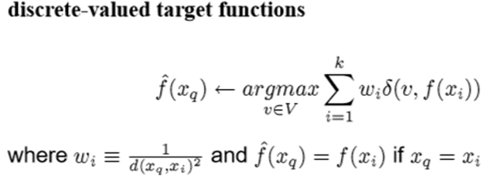
Exercise - 2
Based on the information given in the table below, find the customer type of x_{q}=C4 using K-NN. In given example consider all the instances and use distance weighted K-NN algorithm with kernel K(d(x_{q},x_{i})) = 1/ d(x_{q},x_{i})².
Apply min-max normalization on income to obtain [0,1] range. Consider profession and Region as nominal. Consider :Locality as ordinal variable with ranking order of [Village, Small Town, Suburban, Metropolitan]. Give equal weight to each attribute.
Customer | Income | Profession | Region | Locality | Category
C0 | 60000 | Doctor | Hindi | Village | L1
C1 | 70000 | Doctor | Bengali | Village | L2
C2 | 60000 | Carpenter | Hindi | Suburban | L2
C3 | 80000 | Doctor | Bhojpuri | Metropolitan | L2
C5 | 80000 | Data Scientist | Hindi | Small Town | L1
C4 | 50000 | Data Scientist | Hindi | Small Town

Slide 54
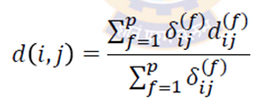
Proximity Measures for Attributes of Mixed Type
Approach
Process all attribute types together, performing a single analysis
Combine the different attributes into a single dissimilarity matrix, bringing all of the meaningful attributes onto a common scale of the interval [0.0, 1.0]
Suppose that the data set contains p attributes of mixed type
The dissimilarity d(i, j) between objects i and j is defined as:
Where indicator 𝛿_{ij}^{(f)} = 0, if either
x_{if} or x_{jf} is missing (i.e., there is no measurement of attribute f for object i or j), OR
x_{if} = x_{jf} = 0 and attribute f is asymmetric binary
Otherwise
𝛿_{ij}^{(f)} = 1

Slide 55
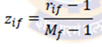
Proximity Measures for Attributes of Mixed Type
If f is ordinal : convert ordinal attribute to Z_{if}
Compute rank r_{if} and M_{f} = number of ordered states, calculate
Treat Z_{if} as numeric
If f is numeric then d_{ij} is calculated as
1. apply min-max normalization
2. Euclidian distance between i and j
If f is nominal then apply simple matching :
p = total number of attributes describing the objects
m = number of matches (i.e., the number of attributes for which i and j are in the same state),

Slide 56
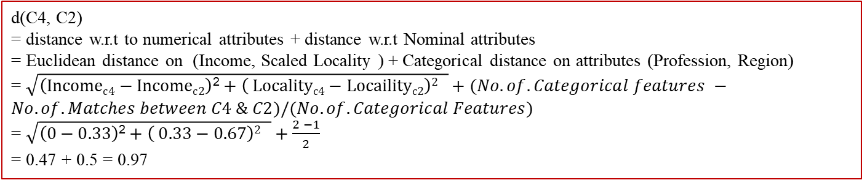
Exercise - 2
Based on the information given in the table below, find the customer type of x_{q}=C4 using K-NN. In given example consider all the instances and use locally weighted K-NN algorithm with kernel K(d(x_{q},x_{i})) = 1/ d(x_{q},x_{i})².
Apply min-max normalization on income to obtain [0,1] range. Consider profession and Region as nominal. Consider :Locality as ordinal variable with ranking order of [Village, Small Town, Suburban, Metropolitan]. Give equal weight to each attribute.
Customer | Income | Profession | Region | Scaled Locality | Category
C0 | 0.33 | Doctor | Hindi | 1 → 0 | L1
C1 | 0.67 | Doctor | Bengali | 1 → 0 | L2
C2 | 0.33 | Carpenter | Hindi | 3 → 0.67 | L2
C3 | 1 | Doctor | Bhojpuri | 4 → 1 | L2
C5 | 1 | Data Scientist | Hindi | 2 → 0.33 | L1
C4 | 0 | Data Scientist | Hindi | 2 → 0.33
Distance | Weight
0.97 | 1.06
1.75 | 0.33
0.97 | 1.06
2.2 | 0.21
1 | 1
0 (NA)
d(C4, C2)
= distance w.r.t to numerical attributes + distance w.r.t Nominal attributes
= Euclidean distance on (Income, Scaled Locality ) + Categorical distance on attributes (Profession, Region)
= $\sqrt{\left(Incomec4−Incomec2\right)\text{2}+\left( Localityc4−Locailityc2\right)2 }+(No.of.Categorical features −No.of.Matches between C4 \& C2)/(No.of.Categorical Features)$
= $\sqrt{\left(0−0.33\right)\text{2}+\left( 0.33−0.67\right)2 }+\frac{2 −1}{2}$
= 0.47 + 0.5 = 0.97

Slide 57
Exercise - 2
Based on the information given in the table below, find the customer type of x_{q}=C4 using K-NN. In given example consider all the instances and use distance weighted K-NN algorithm with kernel K(d(x_{q},x_{i})) = 1/ d(x_{q},x_{i})².
Apply min-max normalization on income to obtain [0,1] range. Consider profession and Region as nominal. Consider :Locality as ordinal variable with ranking order of [Village, Small Town, Suburban, Metropolitan]. Give equal weight to each attribute.
Customer | Income | Profession | Region | Scaled Locality | Category
C0 | 0.33 | Doctor | Hindi | 1 → 0 | L1
C1 | 0.67 | Doctor | Bengali | 1 → 0 | L2
C2 | 0.33 | Carpenter | Hindi | 3 → 0.67 | L2
C3 | 1 | Doctor | Bhojpuri | 4 → 1 | L2
C5 | 1 | Data Scientist | Hindi | 2 → 0.33 | L1
C4 | 0 | Data Scientist | Hindi | 2 → 0.33
Distance | Weight
0.97 | 1.06
1.75 | 0.33
0.97 | 1.06
2.2 | 0.21
1 | 1
0 (NA)
Point | Weight | Class
C5 | 1 | L1
C0 | 1.06 | L1
C2 | 1.06 | L2
C1 | 0.33 | L2
C3 | 0.21 | L2
Inference : Without weighted KNN, L2 is the majority voted class. (take sum of count of each class)
But with weighted distances, L1 class instances are more similar to C4 (take sum of weights of each class)

Slide 58
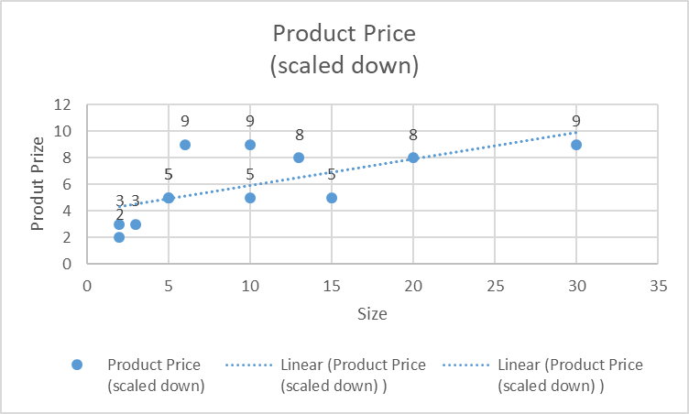
Exercise - 3
Consider the following training set in 2-dimensional Euclidean space. What is the prize of the product with size 7 if 5-NN is considered? Use the kernel of the form K(d(x_{q},x_{i})) = exp( - d(x_{q},x_{i})² / 2b²) where b=1. Use the linear regression of the form y = 3.5 + 0.8 Size and the learning rate of 0.5 to apply the gradient descent and update the weights at the end of first iteration
Size | Product Price (scaled down)
10 | 5
5 | 5
2 | 2
3 | 3
5 | 5
15 | 5
30 | 9
20 | 8
6 | 9
2 | 3
10 | 9
13 | 8

Slide 59
Exercise - 3
Consider the following training set in 2-dimensional Euclidean space. What is the prize of the product with size 7 if 5-NN is considered? Use the kernel of the form K(d(x_{q},x_{i})) = exp( - d(x_{q},x_{i})² / 2b²) where b=1. Use the linear regression of the form y = 3.5 + 0.8 Size and the learning rate of 0.5 to apply the gradient descent and update the weights at the end of first iteration
Size | Product Price (scaled down)
10 | 5
5 | 5
2 | 2
3 | 3
5 | 5
15 | 5
30 | 9
20 | 8
6 | 9
2 | 3
10 | 9
13 | 8
Considering the 5-NN of the query point x= size = 7

Slide 60
Locally weighted linear regression
regression
For a given query point x_{q} we solve the following weighted regression problem using gradient descent training rule:
Note that we need to solve a new regression problem for every query point—that’s what it means to be local.
In ordinary linear regression, we solved the regression problem once, globally, and then used the same h_{w} for any query point.
This is used in GD formula for calculation of Delta Wi
Note: + sign in weight update rule as in Δw_{i} (actual-prediction ) is used.
If we use (prediction – actual) then instead of ‘+’, ‘-’ sign will be used.

Slide 61
Exercise - 3
Consider the following training set in 2-dimensional Euclidean space. What is the prize of the product with size 7 if 5-NN is considered? Use the kernel of the form K(d(x_{q},x_{i})) = exp( - d(x_{q},x_{i})² / 2b²) where b=1. Use the linear regression of the form Price = 3 + 0.8 Size and the learning rate of 0.2 to apply the gradient descent and update the weights at the end of first iteration
Size | Product Price (scaled down) | d(xq, xi) | K(d(x_{q},x_{i}))
10 | 5 | 3 | 0.01
5 | 5 | 2 | 0.14
2 | 2 | 5
3 | 3 | 4
5 | 5 | 2 | 0.14
15 | 5 | 8
30 | 9 | 23
20 | 8 | 13
6 | 9 | 1 | 0.61
2 | 3 | 5
10 | 9 | 3 | 0.01
13 | 8 | 6
Apply gradient descent where the gradient is weighed by the kernel output. Initial values
w0=3, w1=0.8
Answer :
Updated weights after 1st iteration
w1 = 0.95, w0= 3.02
Price Prediction | 9.699758 | After 1st iteration of GD
 | 8.6 | Before GD

Slide 62
Thank You
5 August 2023

